Slide 1


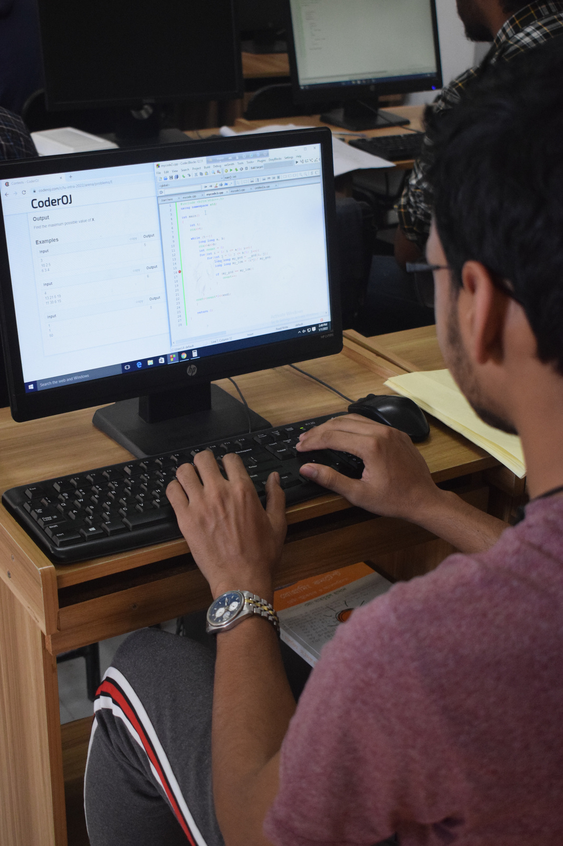
REQUIREMENT ELICITATION
PHARMACY MANAGEMENT SYSTEM

Slide 2

Overview
Our Team
What is Requirement Elicitation
What we did & how we did
Experience
Questions & answers

Slide 3






Our Team
Md Mahmud Hossain Ferdous
Hasan Ahmed
Shah Sayem Ahmad
ID: 2122020003
ID: 2122020030
ID: 2122020043

Slide 4

What is Requirement Elicitation
Requirement Elicitation is the process of gathering, analyzing and documenting requirements from stakeholders to understand their needs and expectations for a particular system or project. This process involves interviews, surveys, brainstorming, observations etc. to gather information and clarify requirements.

Slide 5

01
Brainstorming & disscussion
What we did & how we did
Preparation & question making for interview
02
03
Taking interview in a pharmacy
04
Take all data & prepare the requirement elicitation

Slide 6


EXPERIENCE
It was a mixed experience with the favourable situation and unfavourable situation

Slide 7



Any questions?
Feel free to ask

Slide 8
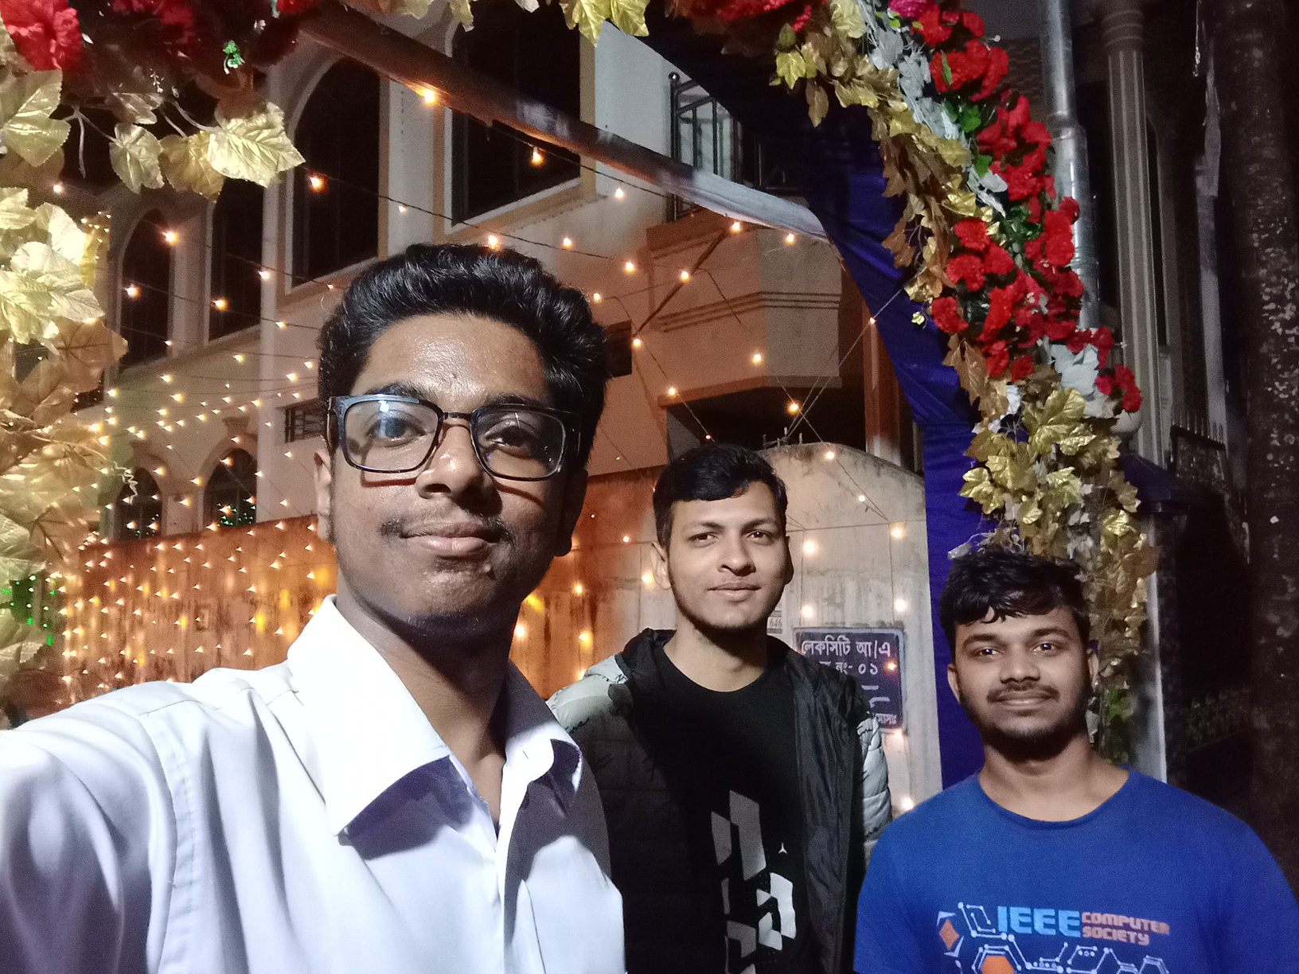
Thanks For Listening

